Slide 1
Fake News Detection
Yueyang Qin
Koganti Sri Harsha

Slide 2
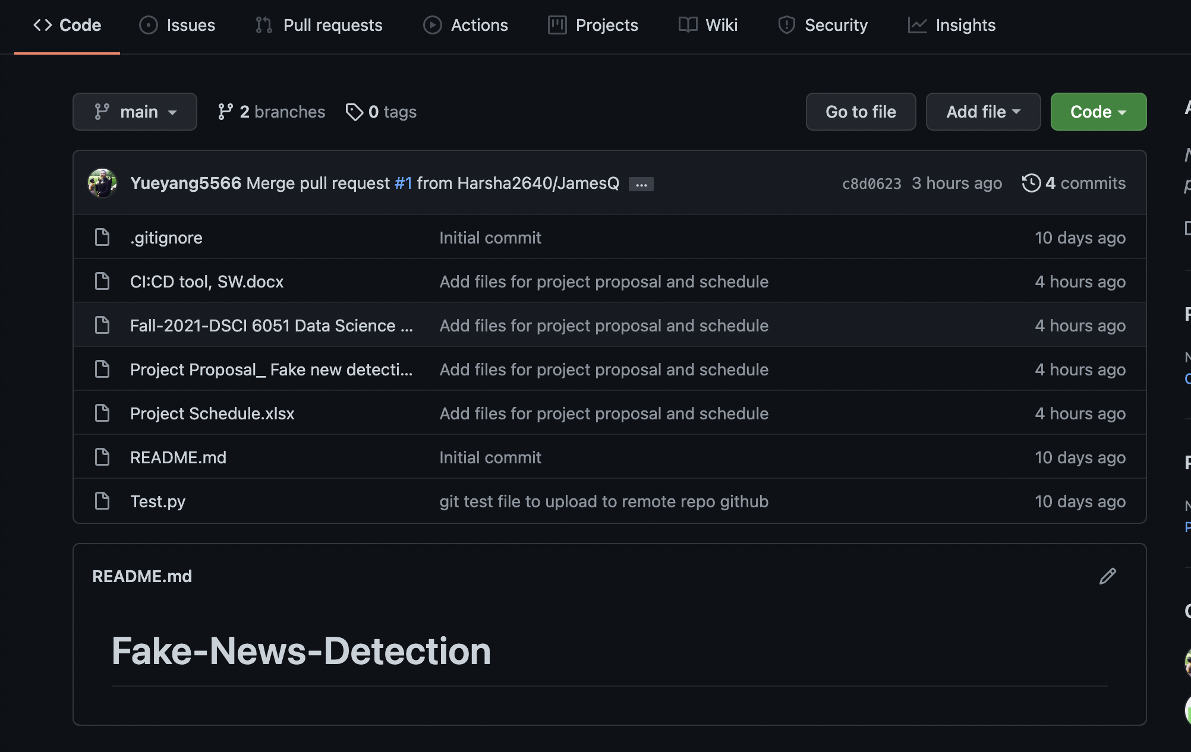
Github repo link: https://github.com/Harsha2640/Fake-News-Detection

Slide 3
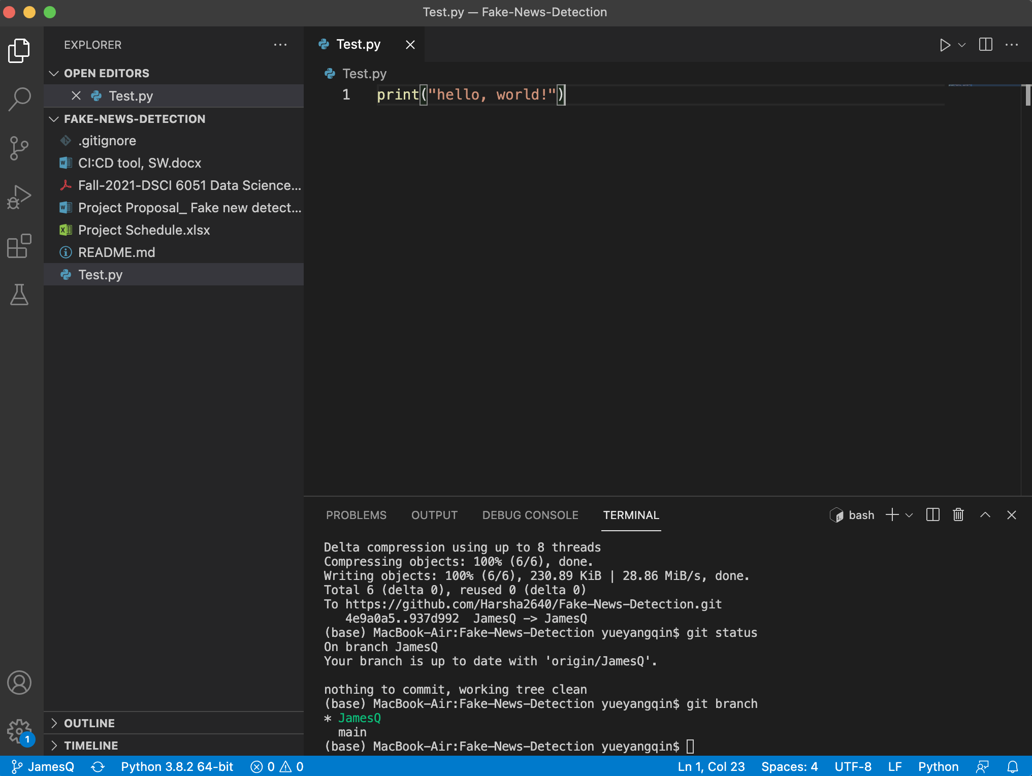
VS code

Slide 4

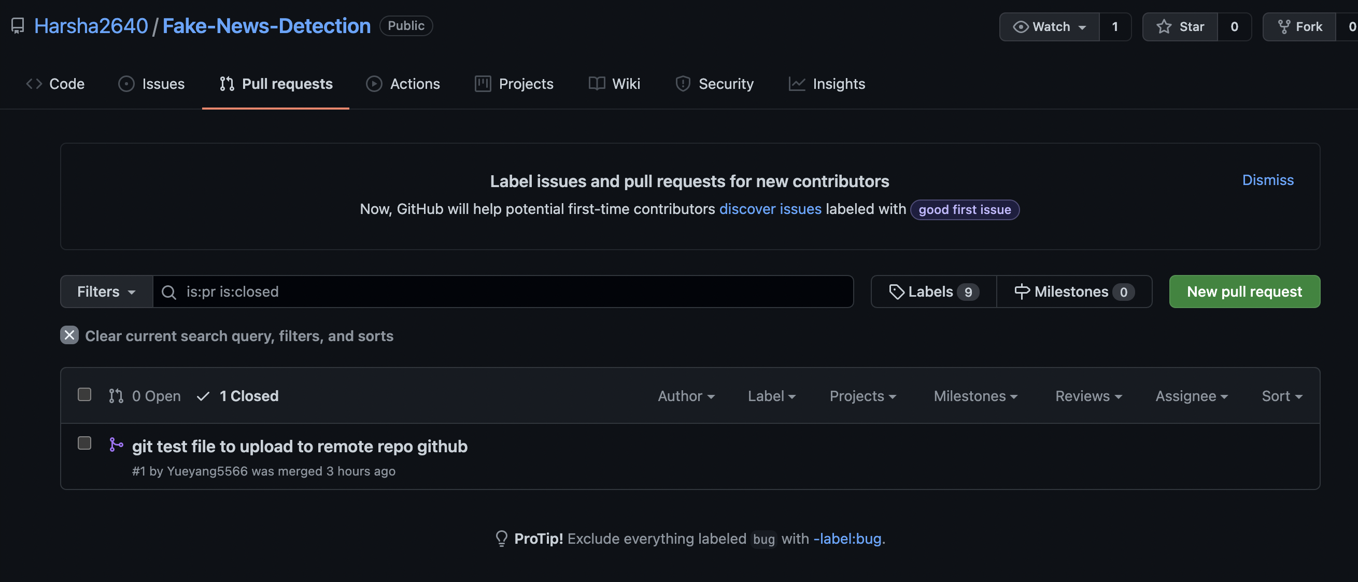
Github pull request from branch

Slide 5
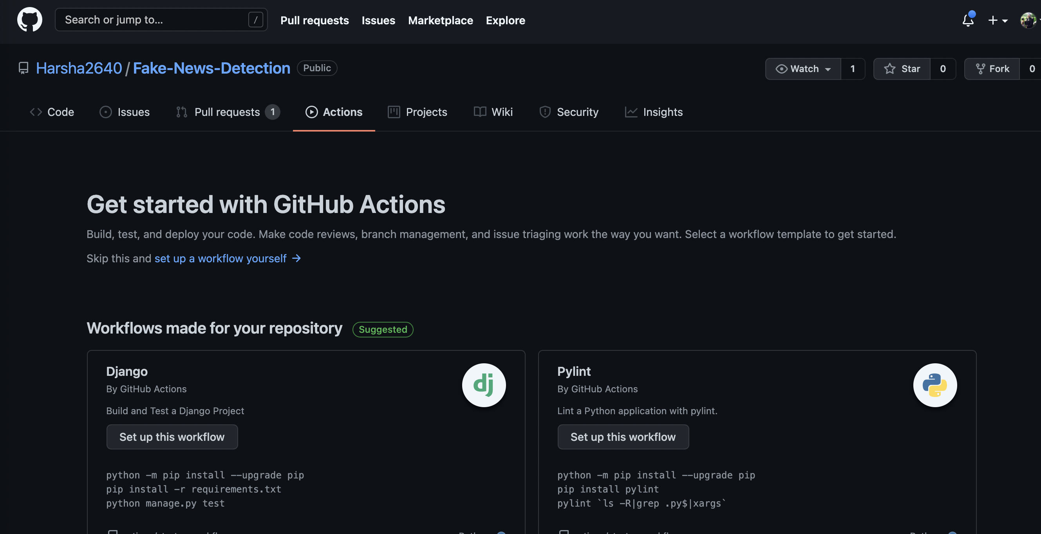
Github Action (still working on the workflow)

Slide 6
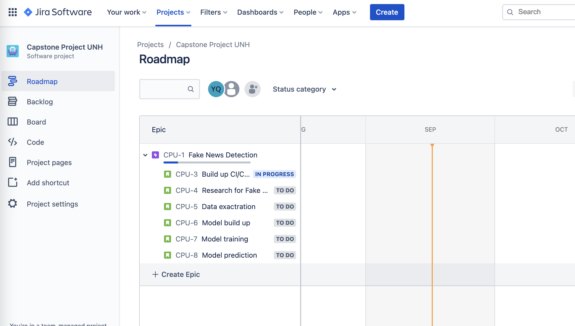
Jira software board

